Slide 1
ENTR 451
Class 3
Jan. 12

Slide 2
La Linia Barca Agenda
Review of Targeting
What are you choosing to be your company’s target market for your plan?
Which target did I choose for Barcelona SAE
Positioning
Differentiation

Slide 3
Target
A target market is a set of buyers who share common needs or characteristics that the company decides to serve
Demographic
Geographic
Psychographic
Behavior
Must be:
Measurable, Accessible, Substantial, Differentiable, Actionable

Slide 4
Barcelona SAE – I choose Target #1
 | Target Group #1 | Target Group #2 | Target Group #3
Demographic | 4-year undergrad colleges with 18-22 year olds; predominantly women; upper income; highly educated; parents are ambitious baby boomers | 4-year undergrad and grad colleges with 18-40 year olds; predominantly women; commuter and community colleges | 21-25 year old recent graduates and those taking a year or two "off"; prediminantly women; upper income; highly educated
Geographic | suburban or urban USA campuses; mid-atlantic and strong economic areas | suburban or urban USA campuses; all USA | suburban or urban USA
Psychographic | Upper-middle class; high discretionary income; highly social; cosmopolitan | middle class; moderate discretionary income; very hard working very competitive | Upper-middle class; high family discretionary income; highly social; cosmopolitan
Behavior | Appreciates kids being idolized; wants the best for children and can pay for it; will do anything for child to have a leg up; entertains often; wine drinkers; fun; worldly; vacations a lot; loyal to quality and values quality; leaders; kids take as many classes and as many opportunities as possible; winners | Want kids to have opportunities they never had; will spend outside their means for child to have a leg up; saves money; beer drinkers; social; loyal to quality and values quality; followers who dream of being more; kids work hard; dreamers | Looking for "meaning" and something different; wants to change the world or affect the world; looking to break out of comfort zone; entertains often; wine drinkers; fun; worldly; risk taker

Slide 5
Why?
Measurable – I can get figures from each entrepreneurship program in the country, but focus in on:
Top 25 Undergrad and Grad Entrepreneurship Program – U.S. News and World Report
Accessible: email, snail mail, direct mail, social media, advertising
Substantial: It can be any program, so I large number
Differentiable: these organizations have a commitment to entrepreneurship; competitive
Actionable: Yes

Slide 6
Type of Strategy
This would be a concentrated strategy, as we are going after a large part of the entrepreneurial studies market, at the first contact
Then, it becomes individualized micromarketing as we customize a program to the school and professor

Slide 7
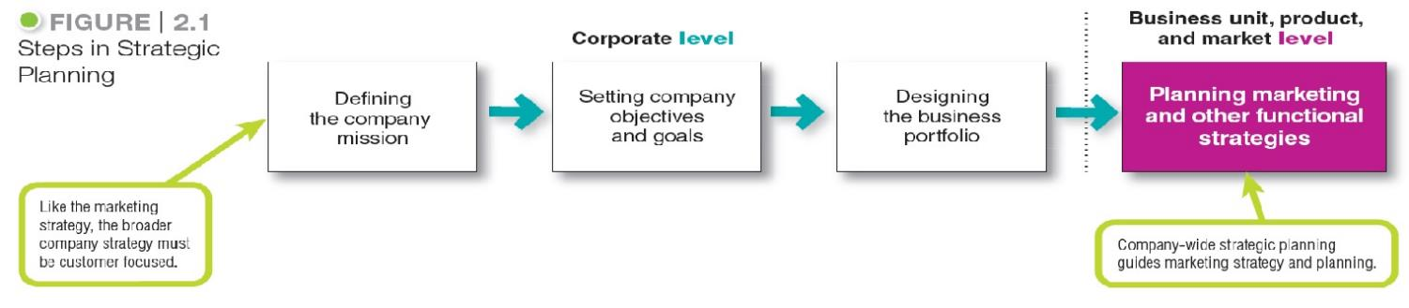
Company-Wide Strategic Planning
Steps in Strategic Planning
Notes:
At the corporate level, the company starts the strategic planning process by defining its overall purpose and mission (see Figure 2.1).
This mission is then turned into detailed supporting objectives that guide the entire company. Next, headquarters decides what portfolio of businesses and products is best for the company and how much support to give each one. In turn, each business and product develops detailed marketing and other departmental plans that support the company-wide plan.
Thus, marketing planning occurs at the business-unit, product, and market levels.
It supports company strategic planning with more detailed plans for specific marketing opportunities.

Slide 8
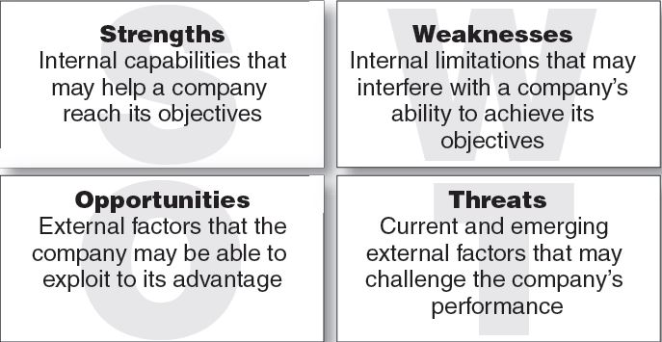
Managing the Marketing Effort
Marketing Analysis – SWOT Analysis
Internal
External
Positive
Negative
Notes:
The company should analyze its markets and marketing environment to find attractive opportunities and identify environmental threats.
It should analyze company strengths and weaknesses as well as current and possible marketing actions to determine which opportunities it can best pursue.
The goal is to match the company’s strengths to attractive opportunities in the environment, while simultaneously eliminating or overcoming the weaknesses and minimizing the threats.
Marketing analysis provides inputs to each of the other marketing management functions.

Slide 9
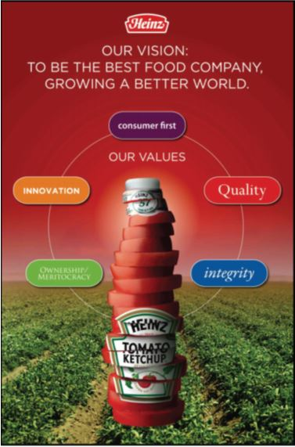
Company-Wide Strategic Planning
Setting Company Objectives and Goals
Heinz’s overall objective is to build profitable customer relationships by developing foods “superior in quality, taste, nutrition, and convenience” that embrace
its nutrition and wellness mission.
H.J. Heinz Company
Notes:
The Heinz company’s mission reflects business objectives and marketing objectives to build profitable customer relationships by developing superior products.

Slide 10
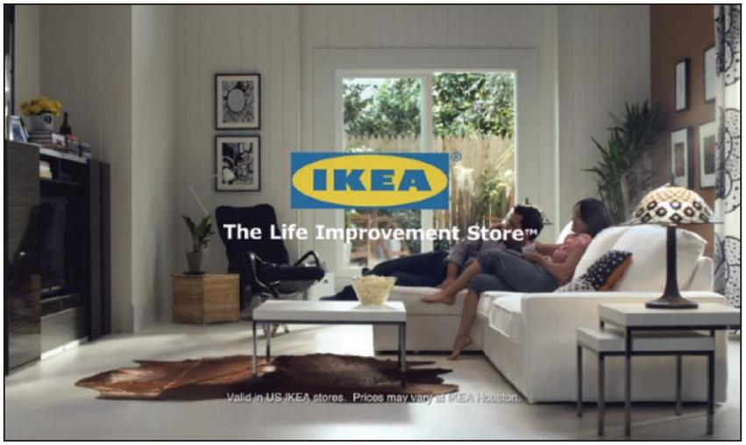
Differentiation and Positioning
Product position is the way the product is defined by consumers on important attributes.
Notes:
Positioning: IKEA does more than just sell affordable home furnishings; it’s the “Life improvement store.”
The company must decide on a value proposition—how it will create differentiated value for targeted segments and what positions it wants to occupy in those segments. The place the product occupies in consumers’ minds relative to competing products is the position. Products are made in factories, but brands happen in the minds of consumers.
Dreft is positioned as the gentle detergent for baby clothes; at IHOP, you “Come hungry. Leave happy.”; at Olive Garden, “When You’re Here, You’re Family.” In the automobile market, the Nissan Versa and Honda Fit are positioned on economy, Mercedes and Cadillac on luxury, and Porsche and BMW on performance.
To simplify the buying process, consumers organize products, services, and companies into categories and “position” them in their minds. A product’s position is the complex set of perceptions, impressions, and feelings that consumers have for the product compared with competing products.
Consumers position products with or without the help of marketers. But marketers do not want to leave their products’ positions to chance. They must plan positions that will give their products the greatest advantage in selected target markets, and they must design marketing mixes to create these planned positions.

Slide 11
Definition of Positioning (from website)
Positioning helps establish your product's or service's identity within the eyes of the purchaser. A company's positioning strategy is affected by a number of variables related to customers' motivations and requirements, as well as by its competitors' actions.
Answer these questions:
What’s the customer really buying from you?
How is your product or service different from your competitors?
What makes your product or service unique?

Slide 12
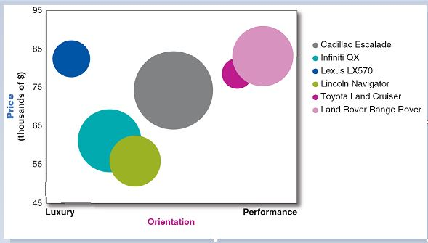
Differentiation and Positioning
Positioning Maps
Positioning maps show consumer perceptions of marketer’s brands versus competing products on important buying dimensions.
Notes:
In planning their differentiation and positioning strategies, marketers often prepare perceptual positioning maps. The position of each circle on the map indicates the brand’s perceived positioning on two dimensions: price and orientation (luxury versus performance). The size of each circle indicates the brand’s relative market share.

Slide 13
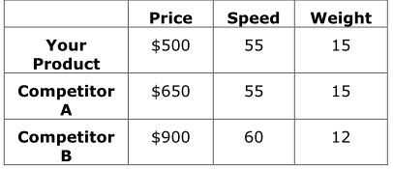
Differentiation and Positioning
Choosing a Differentiation and
Positioning Strategy
Competitive advantage is an advantage over competitors gained by offering consumers greater value, either through lower prices or by providing more benefits that justify higher prices.
Entrepreneurial Action - Caspe 3.2 – 3.3.5 → Questions on Pg. 114-115
Notes:
To build profitable relationships with target customers, marketers must understand customer needs and deliver more customer value better than competitors do. To the extent that a company can differentiate and position itself as providing superior customer value, it gains competitive advantage.
But solid positions cannot be built on empty promises. If a company positions its product as offering the best quality and service, it must actually differentiate the product so that it delivers the promised quality and service. Companies must do much more than simply shout out their positions with slogans and taglines. They must first live the slogan.

Slide 14
Differentiation and Positioning
Choosing a Differentiation and
Positioning Strategy
Identifying a set of possible competitive advantages to build a position
Choosing the right competitive advantages
Selecting an overall positioning strategy
Communicating and delivering the chosen position to the market
Notes:
Firms must differentiate their offers by building a unique bundle of benefits that appeals to a substantial group within the segment. Above all else, a brand’s positioning must serve the needs and preferences of well-defined target markets.
For example, although both Dunkin’ Donuts and Starbucks are coffee and snack shops, they target very different customers, who want very different things from their favorite coffee seller. Starbucks targets more upscale professionals with more high-brow positioning. In contrast, Dunkin’ Donuts targets the “average Joe” with a decidedly more low-brow, “everyman” kind of positioning. Yet each brand succeeds because it creates just the right value proposition for its unique mix of customers

Slide 15

Differentiation and Positioning
Choosing a Differentiation and
Positioning Strategy
Identifying a set of possible competitive advantages to
differentiate along the lines of:
Product
Services
Channels
People
Image
Copyright © 2016 Pearson Education, Inc.
7-42
Notes:
Product differentiation: Premium audio brand Bose promises “better sound through research—an innovative, high-quality listening experience.”
To find points of differentiation, marketers must think through the customer’s entire experience with the company’s product or service. An alert company can find ways to differentiate itself at every customer contact point.
Through product differentiation, brands can be differentiated on features, performance, or style and design. Thus, Bose positions its speakers on their striking design and sound characteristics. By gaining the approval of the American Heart Association as an approach to a healthy lifestyle, Subway differentiates itself as the healthy fast-food choice.
Some companies gain services differentiation through speedy, convenient, or careful delivery. For example, First Convenience Bank of Texas offers “Real Hours for Real People.” It is open seven days a week, including evenings.
Firms that practice channel differentiation gain competitive advantage through the way they design their channel’s coverage, expertise, and performance. Amazon.com and GEICO, for example, set themselves apart with their smooth-functioning direct channels.
Companies can also gain a strong competitive advantage through people differentiation—hiring and training better people than their competitors do.
Even when competing offers look the same, buyers may perceive a difference based on company or brand image differentiation. The chosen symbols, characters, and other image elements a brand chooses must be communicated through advertising that conveys the company’s or brand’s personality.

Slide 16
Differentiation and Positioning
Choosing a Differentiation and
Positioning Strategy
Choosing the Right Competitive Advantage
A difference to promote should be:
Distinctive
Superior
Communicable
Preemptive
Affordable
Profitable
Important
7-43
Notes:
Discussion Question
Are you familiar with GEICO advertisements? If so, what is their positioning?
Not all brand differences are meaningful or worthwhile, and each difference has the potential to create company costs as well as customer benefits. A difference is worth establishing to the extent that it satisfies the following criteria:
Important: The difference delivers a highly valued benefit to target buyers.
Distinctive: Competitors do not offer the difference, or the company can offer it in a more distinctive way.
Superior: The difference is superior to other ways that customers might obtain the same benefit.
Communicable: The difference is communicable and visible to buyers.
Preemptive: Competitors cannot easily copy the difference.
Affordable: Buyers can afford to pay for the difference.
Profitable: The company can introduce the difference profitably.
Many companies have introduced differentiations that failed one or more of these tests. Choosing competitive advantages on which to position a product or service can be difficult, yet such choices may be crucial to success. Choosing the right differentiators can help a brand stand out from the pack of competitors. For example, when Nokia introduced its Lumia 1020 smartphone, it didn’t position the phone only on attributes shared with competing models, such as user interface and speed. It positioned it as a smartphone with a 41 megapixel camera with a “reinvented zoom” and “full HD video” that fits today’s digital lifestyles.

Slide 17
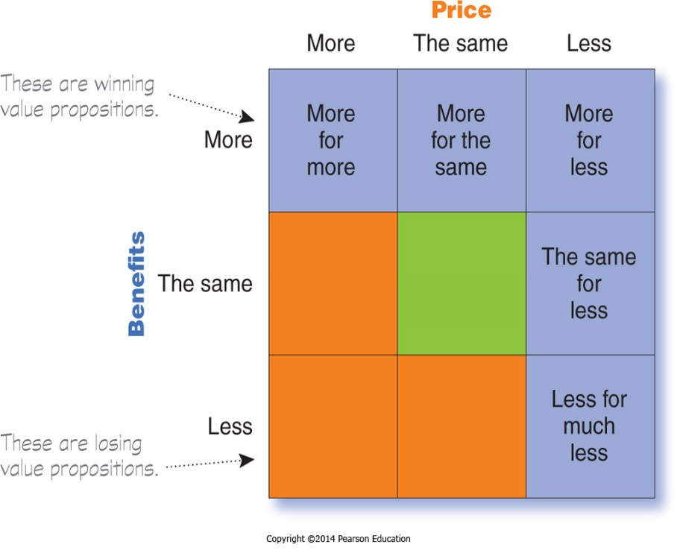
Differentiation and Positioning
Choosing a Differentiation and
Positioning Strategy
Selecting an Overall Positioning Strategy
Value proposition is the full mix of benefits upon which a brand is positioned.
Notes:
The full positioning of a brand is called the brand’s value proposition—the full mix of benefits on which a brand is differentiated and positioned. It is the answer to the customer’s question “Why should I buy your brand?” BMW’s “ultimate driving machine” value proposition hinges on performance but also includes luxury and styling, all for a price that is higher than average but seems fair for this mix of benefits.
Figure 7.4 shows possible value propositions on which a company might position its products. In the figure, the five green cells represent winning value propositions— differentiation and positioning that gives the company a competitive advantage
More for more: This positioning involves providing the most upscale product or service and charging a higher price to cover the higher costs. Although more for more can be profitable, this strategy can also be vulnerable. It often invites imitators who claim the same quality but at a lower price.
More for the same: Companies can attack a competitor’s more for more positioning by introducing a brand offering comparable quality at a lower price. For example, Toyota introduced its Lexus line with a more for the same value proposition versus Mercedes and BMW.
The same for less: Offering the same for less can be a powerful value proposition—everyone likes a good deal. Discount stores such as Walmart and “category killers” such as Best Buy, PetSmart, David’s Bridal, and DSW Shoes use this positioning.
Less for much less: A market almost always exists for products that offer less and therefore cost less. Few people need, want, or can afford “the very best” in everything they buy. In many cases, consumers will gladly settle for less than optimal performance or give up some of the bells and whistles in exchange for a lower price. For example, Family Dollar and Dollar General stores offer more affordable goods at very low prices.
More for less: Of course, the winning value proposition would be to offer more for less. Many companies claim to do this. And, in the short run, some companies can actually achieve such lofty positions. For example, when it first opened for business, Home Depot had arguably the best product selection, the best service, and the lowest prices compared to local hardware stores and other home improvement chains. Offering more usually costs more, making it difficult to deliver on the “for less” promise in the long run.
All said, each brand must adopt a positioning strategy designed to serve the needs and wants of its target markets. More for more will draw one target market, less for much less will draw another, and so on. Thus, in any market, there is usually room for many different companies, each successfully occupying different positions. The important thing is that each company must develop its own winning positioning strategy, one that makes the company special to its target consumers.

Slide 18
Differentiation and Positioning
Choosing a Differentiation and
Positioning Strategy
Positioning statement summarizes company or brand positioning using this form: To (target segment and need) our (brand) is (concept) that (point of difference)
Notes:
The company and brand positioning should be summed up in a positioning statement. An example using the above form is shown on the next slide.
The case for the brand’s superiority is made on its points of difference. For example, the U.S. Postal Service ships packages just like UPS and FedEx, but it differentiates its priority mail from competitors with convenient, low-price, flat-rate shipping boxes and envelopes. “If it fits, it ships,” promises USPS.

Slide 19

Differentiation and Positioning
Choosing a Differentiation and
Positioning Strategy
Positioning Statement Example for Evernote:
“To busy multitaskers who need help remembering things, Evernote is a digital content management application that makes it easy to capture and remember moments and ideas from your everyday life using your computer, phone, tablet, and the Web.”
Notes:
Here is a positioning statement example using the popular digital information management application, Evernote: “To busy multitaskers who need help remembering things, Evernote is a digital content management application that makes it easy to capture and remember moments and ideas from your everyday life using your computer, phone, tablet, and the Web.”
Note that the positioning statement first states the product’s membership in a category (digital content management application) and then shows its point of difference from other members of the category (easily capture moments and ideas and remember them later). Evernote helps you “remember everything” by letting you take notes, capture photos, create to-do lists, and record voice reminders, and then makes them easy to find and access using any device, anywhere—at home, at work, or on the go.

Slide 20
Communicating and Delivering the Chosen Position
Differentiation and Positioning
Choosing the positioning is often easier than implementing the position.
Example: McDonald’s having the same tasting burger everywhere
Establishing a position or changing one usually takes a long time.
Maintaining the position requires consistent performance and communication.
Notes:
Once it has chosen a position, the company must take strong steps to deliver and communicate the desired position to its target consumers. All the company’s marketing mix efforts must support the positioning strategy. Positioning the company calls for concrete action, not just talk. If the company decides to build a position on better quality and service, it must first deliver that position.
Companies must closely monitor and adapt the position over time to match changes in consumer needs and competitors’ strategies. However, the company should avoid abrupt changes that might confuse consumers, and should evolve gradually as it adapts to the ever-changing marketing environment.

Slide 21
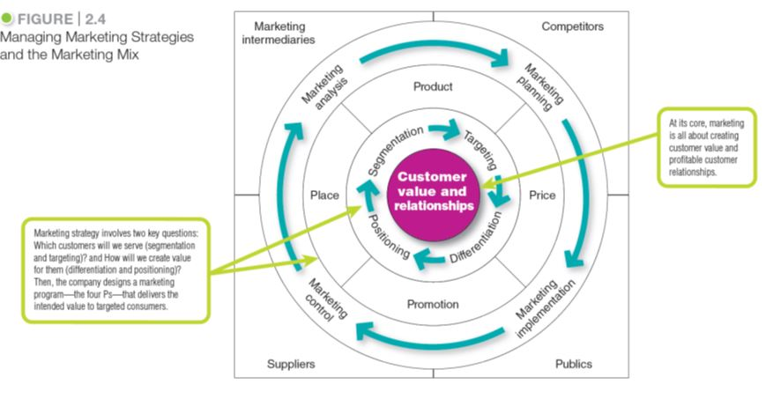
Marketing Strategy and the Marketing Mix
2-21
Notes:
Consumers stand in the center of Figure 2.4 where the goal is to create value for customers and build profitable customer relationships.
Next comes marketing strategy—the marketing logic by which the company hopes to create this customer value and achieve these profitable relationships. The company decides which customers it will serve (segmentation and targeting) and how (differentiation and positioning).
Guided by marketing strategy, the company designs an integrated marketing mix made up of factors under its control—product, price, place, and promotion (the four Ps).
To find the best marketing strategy and mix, the company engages in marketing analysis, planning, implementation, and control.
Through these activities, the company watches and adapts to the actors and forces in the marketing environment.

Slide 22
Marketing Strategy and the Marketing Mix
Customer Value-Driven
Marketing Strategy
Marketing strategy is the marketing logic by which the company hopes to create customer value and achieve profitable customer relationships.

Slide 23

Marketing Strategy and the Marketing Mix
Customer Value-Driven Marketing Strategy
Positioning: The 100-year-old Del Monte brand positions itself as “Bursting with Life: Made in America. Picked and packed at the peak of ripeness.
Same essential ingredients as fresh.”
- Del Monte Corporation
Notes:
The iconic 100-year-old Del Monte brand designed its entire integrated marketing campaign—from television and print ads to its online, mobile, and social media content—around the “Bursting with Life” positioning.
More than just words, the campaign slogan positions Del Monte’s canned fruits and vegetables as quality ingredients that contribute to a healthy lifestyle. They are “grown in America, picked and packed at the peak of ripeness, [and contain the] same essential nutrients as fresh.”

Slide 24
Groups
Create a Positioning Statement for your organization using the framework: To (target segment and need) our (brand) is (concept) that (point of difference)
Describe your Market Strategy thus far, in terms of:
Market Segmentation - a group of consumers who respond in a similar way to a given set of marketing efforts.
Market Targeting - the process of evaluating each market segment’s attractiveness and selecting one or more segments to enter
Market Positioning - the arranging for a product to occupy a clear, distinctive, and desirable place relative to competing products in the minds of target consumers

Slide 25
Michael Porter
Porter argues that a firm’s strengths ultimate fall into one of two headings: cost advantage and differentiation
By applying these strengths in a broad or a narrow focus, three generic strategies result:
Cost leadership
Differentiation
Focus

Slide 26
Porter’s Strategies
Porter identified the four strategies to achieve a competitive advantage, in the area of:
Cost leadership: superior profits through lower costs
Differentiation: higher profits by adding value to the product areas which are of real significance for customers who in turn are willing to pay premium prices
Focus strategy: concentrating on a limited part of the market
Focus strategy is then subdivided into:
Focused cost leadership and
Focused differentiation

Slide 27
Porter’s Generic Strategies
Target scope | Advantage Low cost | Advantage Product uniqueness
Broad (industry wide) | Cost leadership strategy (WalMart) | Differentiation strategy (Proctor & Gamble)
Narrow (market wide) | Focused Low Cost Strategy (Dollar Shave Club) | Focused Differentiation Strategy (Audi)

Slide 28
Generic strategies at a glance
Low cost Low cost culture Economies of scale Eliminate unnecessary costs Enjoy high profits through cost advantage | Differentiation Adding value through -product features -product quality -distinctive offering Offer something new or different High costs but charge premium price | Focus Niche markets Targeting Limited territory Focus on a specific group of customers Either cost leader or differentiation with in the segment

Slide 29
Five forces analysis
Porter developed the five forces model as a framework for the analysis of profitability of the industry
The five forces are:
Supplier’s power: powerful suppliers can push up the cost of inputs
Buyers’ power: powerful buyers can negotiate low prices
The threat of substitutes: where there is a strong threat firms need to remain very competitive
The ease or otherwise of entry to the market: low barriers raise the prospect new firms pushing down prices
The intensity of rivalry in the market: intense competition forces firms to keep prices down
The five forces model can be used to analyze each of the generic strategies

Slide 30
Five forces and cost leadership
The five forces | The cost leader is
Entry barriers | Able to cut prices to discourage potential entrants to the market
Buyer power | Able to offer a competitive price to buyers with power
Supplier power | Insulated from a powerful buyer by low costs
Threat of substitution | Able to make use of low price as defence against substitutes
Rivalry | Is better able to compete on price

Slide 31
Risks of cost leadership
Vulnerability to even lower cost operators
As technology improves, a competitor may be able to leapfrog the production capabilities, thus eliminating the competitive advantage
It could lead to a damaging price wars
There might by difficulty in sustaining cost leadership in the long run
A firm following a focus strategy might be able to achieve even lower cost within their segment

Slide 32
Differentiation
A differentiation strategy calls for the development of a product or service that offers attributes that are both unique and are valued by customers
Customers perceive the product to be different and better than that of rivals
As a result the value added by the uniqueness of the product may allow the firm to charge a premium price for it

Slide 33
Differentiation
Success in a differentiation strategy means
Gaining a competitive advantage by making their product different from competitors
Competing on the basis of value added to customers
Persuading customers that the firm’s product is superior to that offered by rivals
Customers being willing to pay a premium price to cover higher costs
Differentiation can be based on product image or durability, after-sales, quality, additional features, after sales
And it requires flair, research capability and strong marketing

Slide 34
The five forces and differentiation
Five forces | A firm pursuing a differentiation strategy…
Entry barriers | Benefits from customer loyalty which discourages potential entrants
Buyer power | Enjoys some protection since large buyers have less power to negotiate because of the absence of close alternatives
Supplier power | Is better able to pass on supplier price increases to customers
Threat of substitution | Is protected from the threat of substitutes by customer loyalty
Rivalry | Benefits from brand loyalty to keep customers from rivals

Slide 35
Focus strategy
In a focus strategy, the firm concentrates on one, or at most a limited number, of segments of the market
The premise behind this strategy is that the needs of the group can be better served by focusing entirely on it
The firm might feel more secure in the niche with greater insulation from competition
A focus strategy means that the firm’s efforts are not spread too thinly
Focus strategies are
Cost focus: cost leader in a particular segment
Focus differentiation: differentiation in the chosen segment

Slide 36
Benefits of a focus strategy
It involves lower investment in resources
The firm benefits from specialization
It provides scope for greater knowledge of a segment of the market
It makes entry to new markets easier and less costly
Firms using a focus strategy often enjoy a high degree of customer loyalty

Slide 37
The five forces and a focus strategy
The five forces | A firm pursuing a focus strategy…
Entry barriers | Develops core competencies that can act as an entry barrier
Buyer power | Enjoys some insulation since large buyers have less power to negotiate because few alternatives are available
Supplier power | Is better able to pass on supplier price rises thereby reducing the impact of supplier power
Threat of substitution | Enjoys some protection against substitutes by specialized products and core competencies
Rivalry | Enjoys some protection because rivals cannot meet differentiation focused customer needs

Slide 38
Stuck in the middle
Make a conscious choice about the competitive advantage
If it fails to choose one of these strategies, it risks being “stuck in the middle”, trying to be all things to all people, and ends up with no competitive strategy at all
Being stuck in the middle leads to low profitability
Competitors with a clear strategy outperform those whose strategy is unclear or attempt a combination of strategies

Slide 39
What is wrong with being “stuck in the middle”?
It is difficult to simultaneously become differentiated and low cost
The firm loses out to others able to undercut it and to those able to offer a superior product
If a firm differentiates itself by supplying very high quality products, it risks undermining that quality if it seeks to be come a cost leader
Such a firm also suffers from a blurred corporate culture and the projection of a confusing image

Slide 40
Groups
Which of Porter’s 4 generic strategies do you believe your company uses (Cost Leadership, Differentiation, Focused Cost Leadership, Focused Differentiation)?
Analyze your company on each of Porter’s Five Forces (High, Medium, Low)
Supplier’s power: powerful suppliers can push up the cost of inputs
Buyers’ power: powerful buyers can negotiate low prices
The threat of substitutes: where there is a strong threat firms need to remain very competitive
The ease or otherwise of entry to the market: low barriers raise the prospect new firms pushing down prices
The intensity of rivalry in the market: intense competition forces firms to keep prices down

